Slide 1
Discussion 3: Linked Lists & Arrays
Christine Zhou

Slide 2
Agenda
Administrivia
Review of SLLists
SLList problems (1.1, 1.2)
Review of arrays
Array problems (2.1, 2.2)

Slide 3
Preface
Lots of questions on the discussion today. These are for practice! We will not be able to get through all of them.

Slide 4
Administrivia
Project 1A due this Friday!
Implementing deque interface, highly recommend to use Java Visualizer.
Start early!!
Office hours: pay special attention to the locations!
CSM sign-ups will open tonight, 9pm, and is first come first served! Opportunity to get extra help in a small-group setting with a mentor.
Pre-semester advising still available @414 (Email me!)
Choose Mentor GSI’s and see the automated extension system at registration.datastructur.es
Survey: tinyurl.com/cz-disc3-sp19 (please fill this out so I know what to focus on today!)

Slide 5
Review: IntList
public class IntList {
public int first;
public IntList rest;
public IntList(int f, IntList r) {
first = f;
rest = r;
}
...
}
Our IntList! What’s wrong with it?
All the fields are public
Calling each link an IntList does not seem entirely correct...

Slide 6
Review: SLList
Access modifiers changed to private
Outside users cannot access fields directly
Hides the internals using encapsulation
Hide the inner workings of the list from the user, store info about the list (ex. size)
User sees the list as a whole, not the individual nodes of the list, and does not have to deal with logic of pointer manipulation
Analogy: You refer to a train as a whole, not as individual cars. Instead of dealing with the raw links with first and next, you refer to it as a whole.
public class SLList {
private class IntNode {
private int item;
private IntNode next;
private IntNode(int i, IntNode n) {
item = i;
next = n;
}
}
private IntNode first;
public SLList(int x) {
first = new IntNode(x, null);
}
public int get(int position) {
...
}
}

Slide 7
Review: SLList Diagram
We add a size variable so we don’t have to step through the entire linked list every time we want the size
x
“First” is a pointer to the first link in the linked list.
addFirst()
size
first
getFirst()
3
addLast()
We add these methods to abstract away the mechanics of adding items to, and getting items from, our list
size()
5
10
15
item
next

Slide 8
Review: SLList
How do we represent an empty linked list?
Set first to null?
This leads ugly code, as we will have to add a bunch of null checks to code that handles the list.
For example, addLast would need a special case for if the list is null
What can we do instead?
sentinel: a “dummy” node that doesn’t hold any important info, just a placeholder to help us avoid null checks
Goal of sentinel: make code as simple and generic as possible so no special cases

Slide 9
Review: Sentinel Node Diagram
addFirst()
size
first
getFirst()
Instead of pointing to null, first points to the sentinel node.
0
addLast()
size()
??
item
next
The sentinel is not included in the size
addFirst()
size
first
getFirst()
3
addLast()
size()
??
5
10
15
item
next

Slide 10
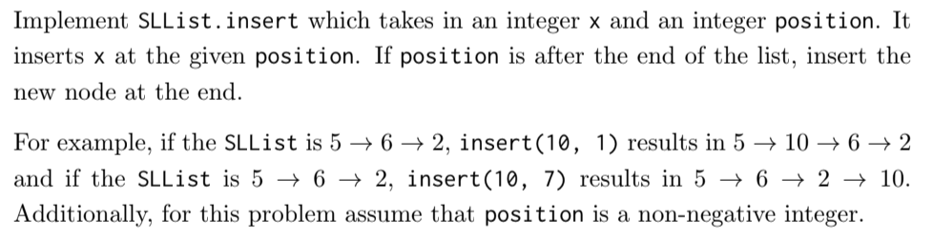
1.1) SLList.insert
Think about what types of things/cases we need to check for
How do we get to the specified position?
When we get there, how to we reassign the pointers?

Slide 11
1.2) SLList.reverse
Drawing an IntList to work with is really helpful for this one
We cannot use new, so we have to use the nodes that already exist
Pointer manipulation
We can only move forward in an SLList, so what does that say about how we are constructing our end product? In what way are we making the end list?
The first element in the original list will become what element in the ending list?
Think about the cases:
Empty list?
List with single element?
List with two, three, four, etc. elements?

Slide 12
Review: DLLists
Lists should have a method where you can remove an element in a certain position
Let’s do this with our SLLists + sentinel!
. . .
5
10
15
Say we want to remove this node

Slide 13
Review: DLLists
Lists should have a method where you can remove an element in a certain position
Let’s do this with our SLLists + sentinel!
. . .
5
10
15
1. We need to jump to that link

Slide 14
Review: DLLists
Lists should have a method where you can remove an element in a certain position
Let’s do this with our SLLists + sentinel!
. . .
5
10
15
2.Save a reference to this node (If we don’t, we will lose it forever! We need it later)

Slide 15
Review: DLLists
Lists should have a method where you can remove an element in a certain position
Let’s do this with our SLLists + sentinel!
. . .
5
10
15
3.Remove its “next” pointer

Slide 16
Review: DLLists
Lists should have a method where you can remove an element in a certain position
Let’s do this with our SLLists + sentinel!
. . .
5
10
15
4.Jump to the node before

Slide 17
Review: DLLists
Lists should have a method where you can remove an element in a certain position
Let’s do this with our SLLists + sentinel!
. . .
5
10
15
5.Reassign next to the node after

Slide 18
Review: DLLists
Had to traverse the list twice to remove!
We can make this a lot faster by adding previous pointers in addition to next pointers.
. . .
5
10
15
Notes:
Having the extra arrows does increase the amount of memory you use.

Slide 19
Review: ALists
Long time to traverse the DLList (have to traverse the whole structure)
What about arrays?
Constant time access!
Can’t resize easily
Let’s try this instead: AList
Underlying structure is an array
Create a resize function so we can support adding/removing
Utilize geometric resizing
Copy all items from the old array into new array
Basically Project 1A: ArrayDeques!

Slide 20
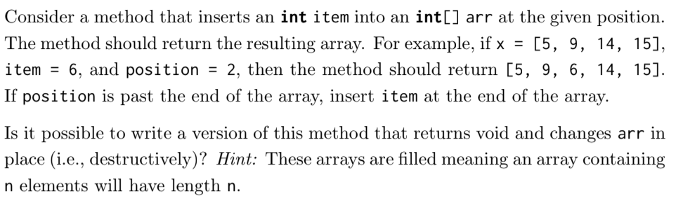
2.1) Array insert

Slide 21
2.1) Array insert
No, because arrays have a fixed length, so to add an element, you need to create a new array.

Slide 22
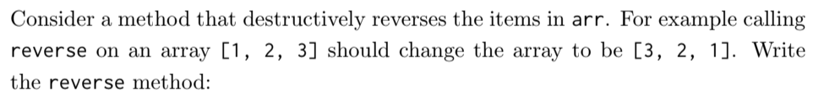
2.2) Array reverse

Slide 23
Exercise 3: Array insert Extra
Write a method that inserts the item into the arr at the specified position. Positions are 0-indexed. If the position goes past the end of the array just insert it at the end.
public static int[] insert(int[] arr, int item, int position)
}

Slide 24
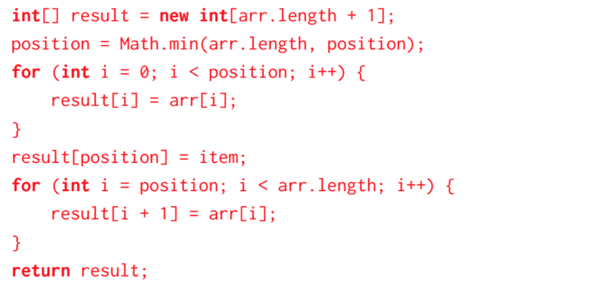
Exercise 3: Array insert Extra
Write a method that inserts the item into the arr at the specified position. Positions are 0-indexed. If the position goes past the end of the array just insert it at the end.
public static int[] insert(int[] arr, int item, int position)
}

Slide 25
Exercise 4: Array reverse Extra
Write a method that reverse the elements in an array destructively.
public static void reverse(int[] arr) {
}

Slide 26
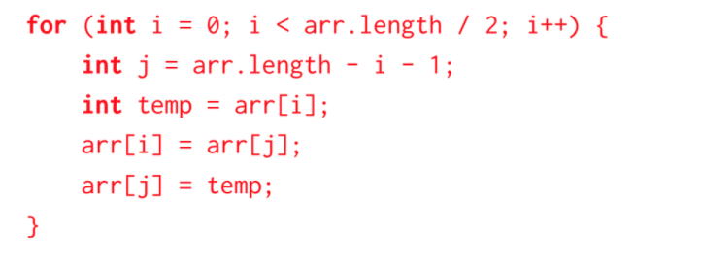
Exercise 4: Array reverse Extra
Write a method that reverse the elements in an array destructively.
public static void reverse(int[] arr) {
}

Slide 27
Exercise 5: Replicate Extra
Write a non-destructive method replicate(int[] arr) that replaces the number at index i with arr[i] copies of itself. For example, replicate([3, 2, 1]) would return [3, 3, 3, 2, 2, 1].
public static int[] replicate(int[] arr) {
}

Slide 28
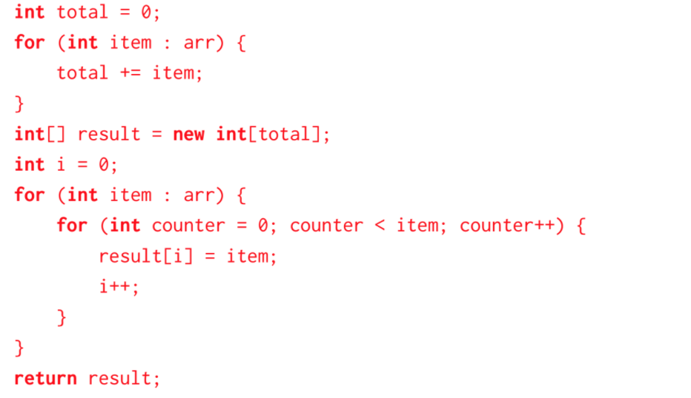
Exercise 5: Replicate Extra
Write a non-destructive method replicate(int[] arr) that replaces the number at index i with arr[i] copies of itself. For example, replicate([3, 2, 1]) would return [3, 3, 3, 2, 2, 1].
public static int[] replicate(int[] arr) {
}

